Slide 1
Introduction To ML
Subhendu Ranjan mishra
15th Jan 2019

Slide 2
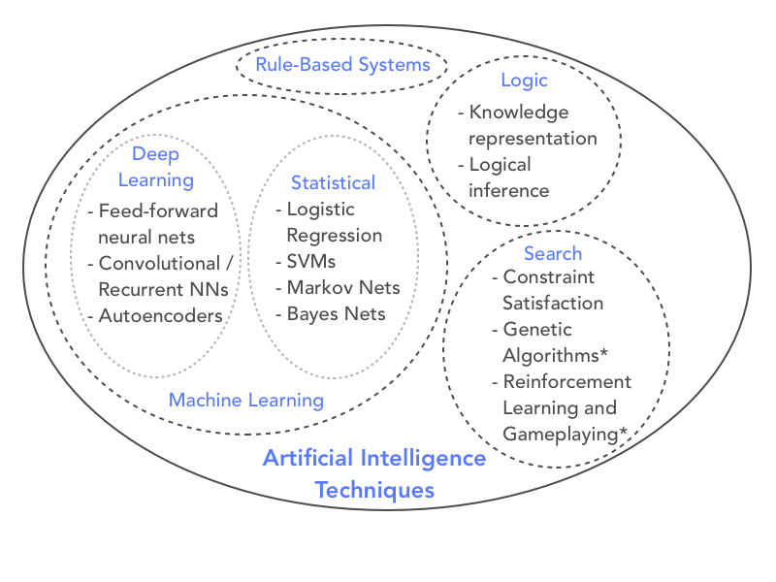
ML vs AI

Slide 3
Types Of ML Tasks
Supervised
Unsupervised
Semi-Supervised

Slide 4
Supervised Leaning
Regression
Classification
Object Detection
Speech Detection
Language Modelling
Translation

Slide 5
Un-Supervised Leaning
Clustering
Self Organized Map
Word Embedding
Auto Encoder

Slide 6
Semi-Supervised Leaning
Recommendation Engines
Self Driving Car
Game Play Engines
Reinforcement Learning

Slide 7
Types of Algorithms Few Examples of Classical ML Algorithms (Not Exhaustive)
Classical
Regression
Linear Regression
Logistic Regression
Elastic Net
Classification
SVM
Decision Tree
Random Forest
Clustering
K-Means
LDA
Affinity Propagation

Slide 8
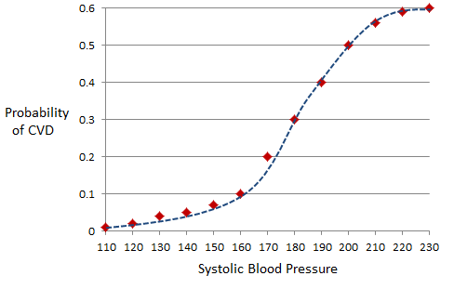
Logistic regression

Slide 9
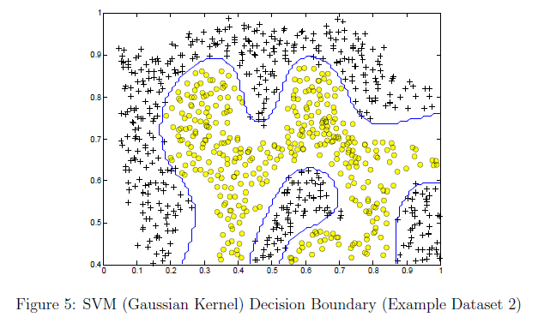
SVM

Slide 10

Random Forest

Slide 11
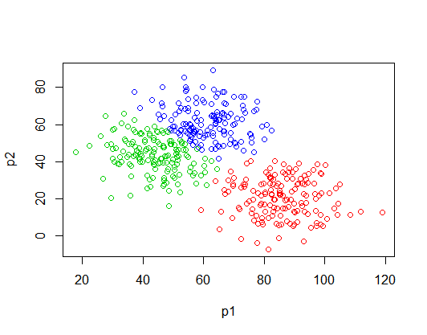
K-Means

Slide 12
Types of Algorithms contd..
Neural Network / Deep Learning
Multi Layered Perceptron
Convolutional Neural Net
Word Embedding's
Recurrent Neural Networks
Self Organizing Maps

Slide 13
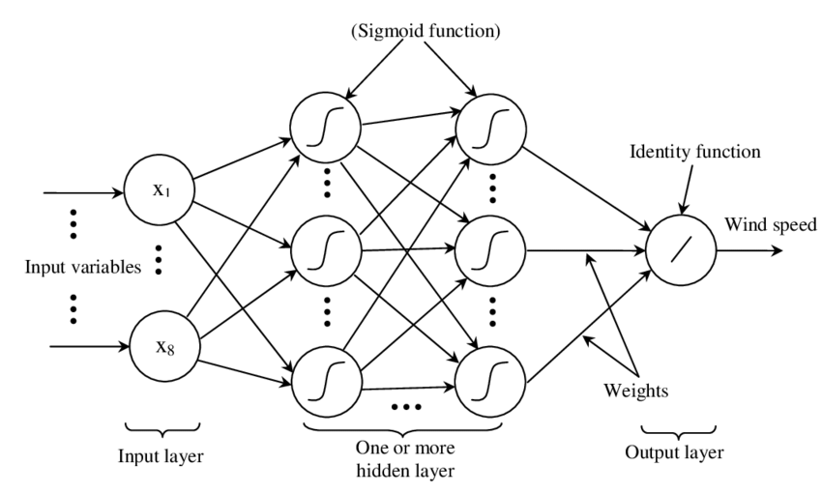
MLP

Slide 14
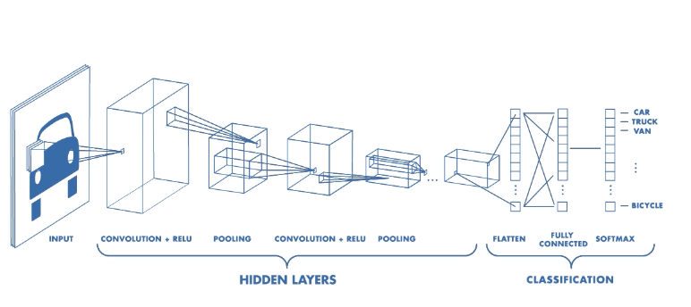
CNN

Slide 15
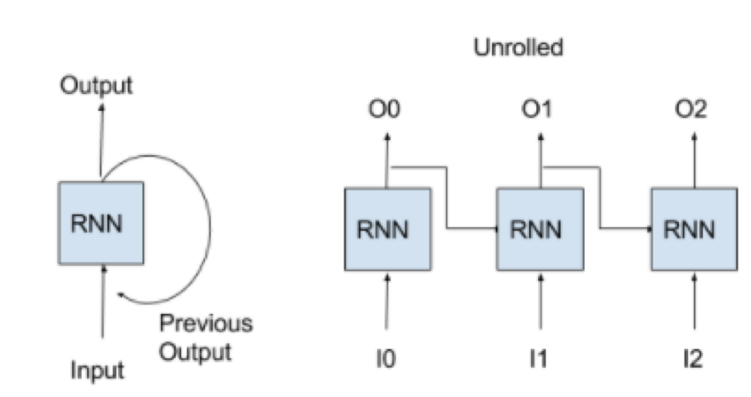
RNN

Slide 16
Tools and Libraries
Python
Numpy
Pandas
Sklearn
Tensorflow
Keras
Matplotlib

Slide 17
Plan of Study
Python
Numpy & Pandas
skleran
Keras / TF
MLP
CNN
RNN

Slide 18
Thank You

